Slide 1
Uniform keyboard teaching assistant
A.C.T.M. part of the project

Slide 2
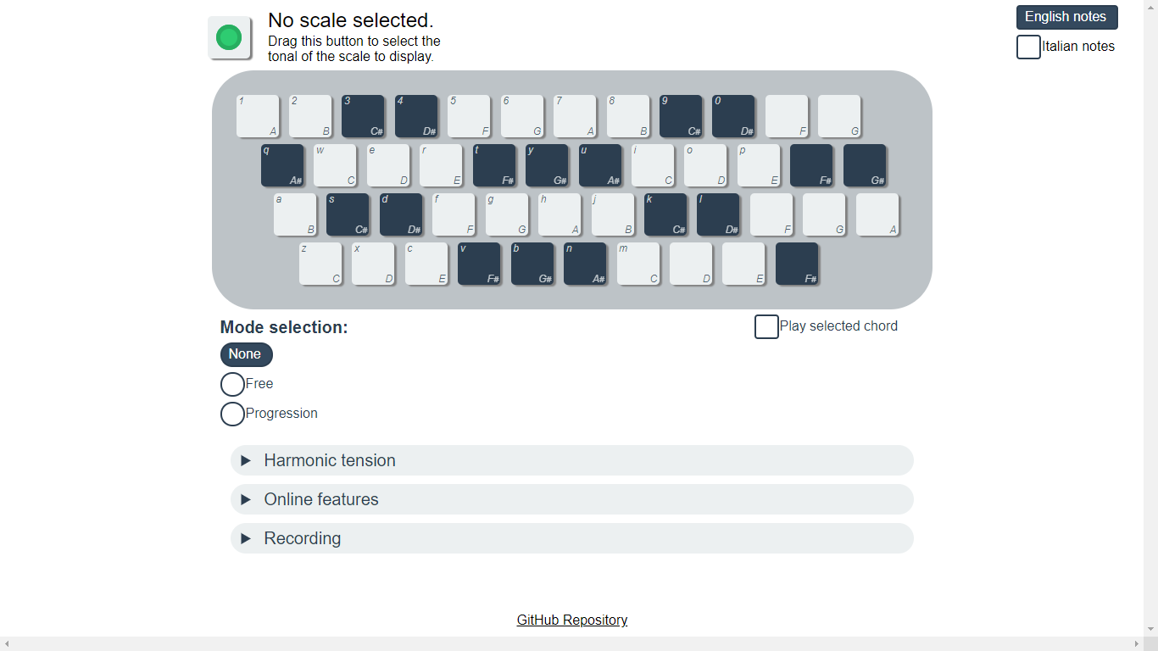
First look

Slide 3
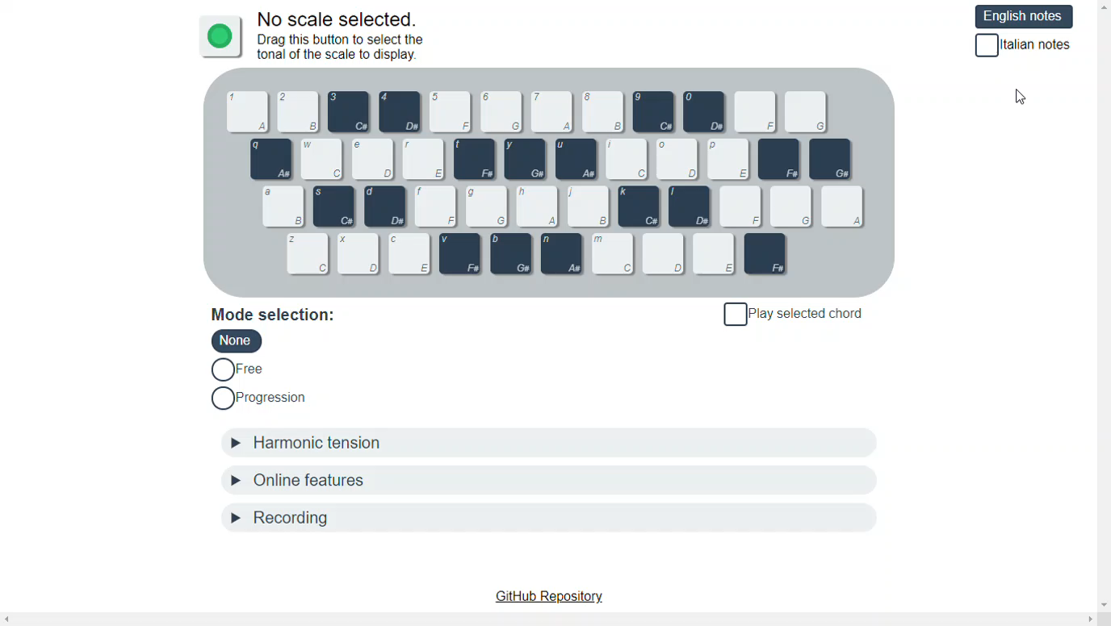
Note labels

Slide 4
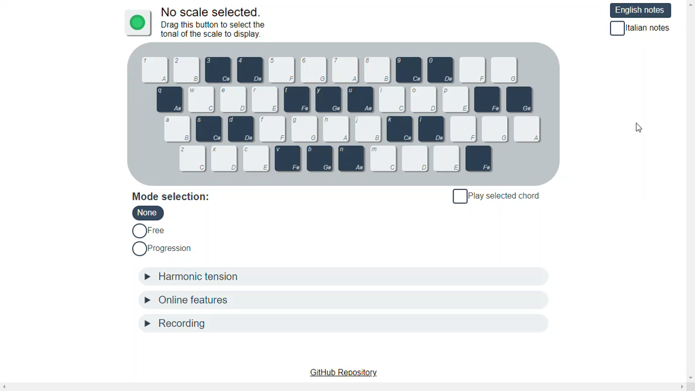
Selecting a scale

Slide 5
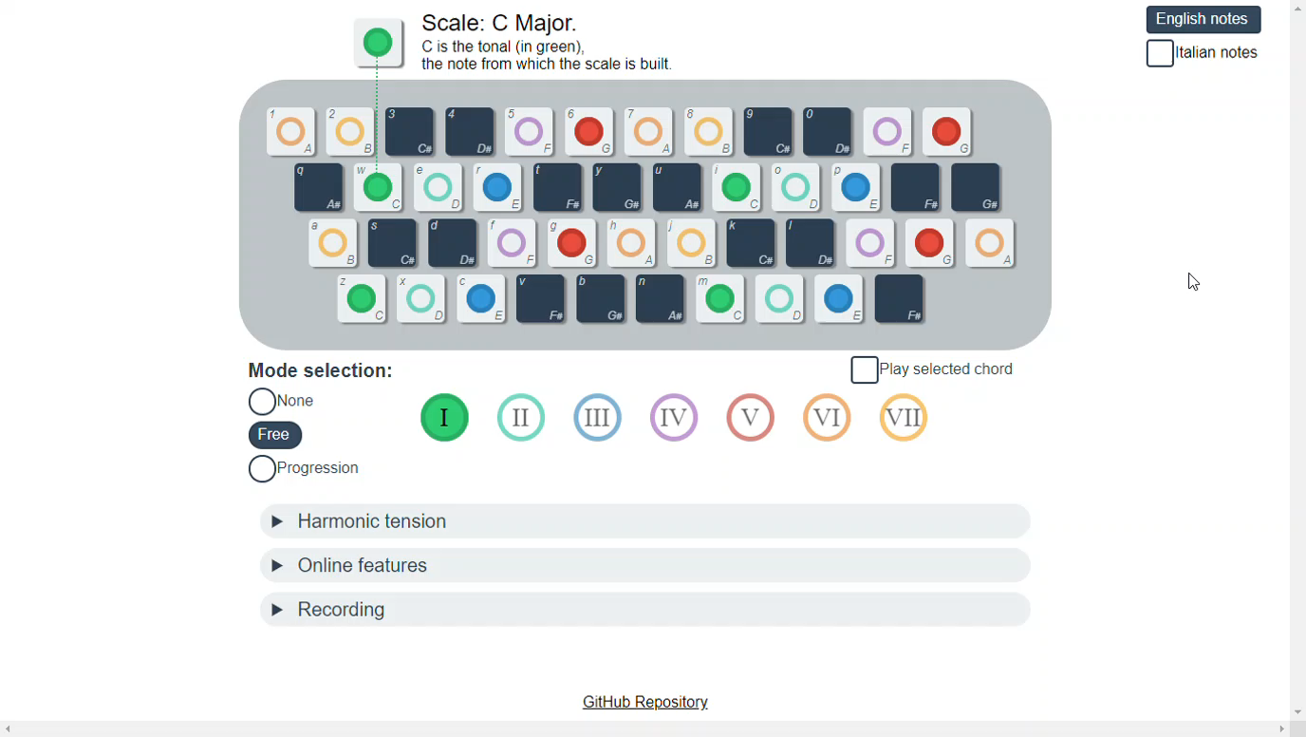
Selecting a mode

Slide 6

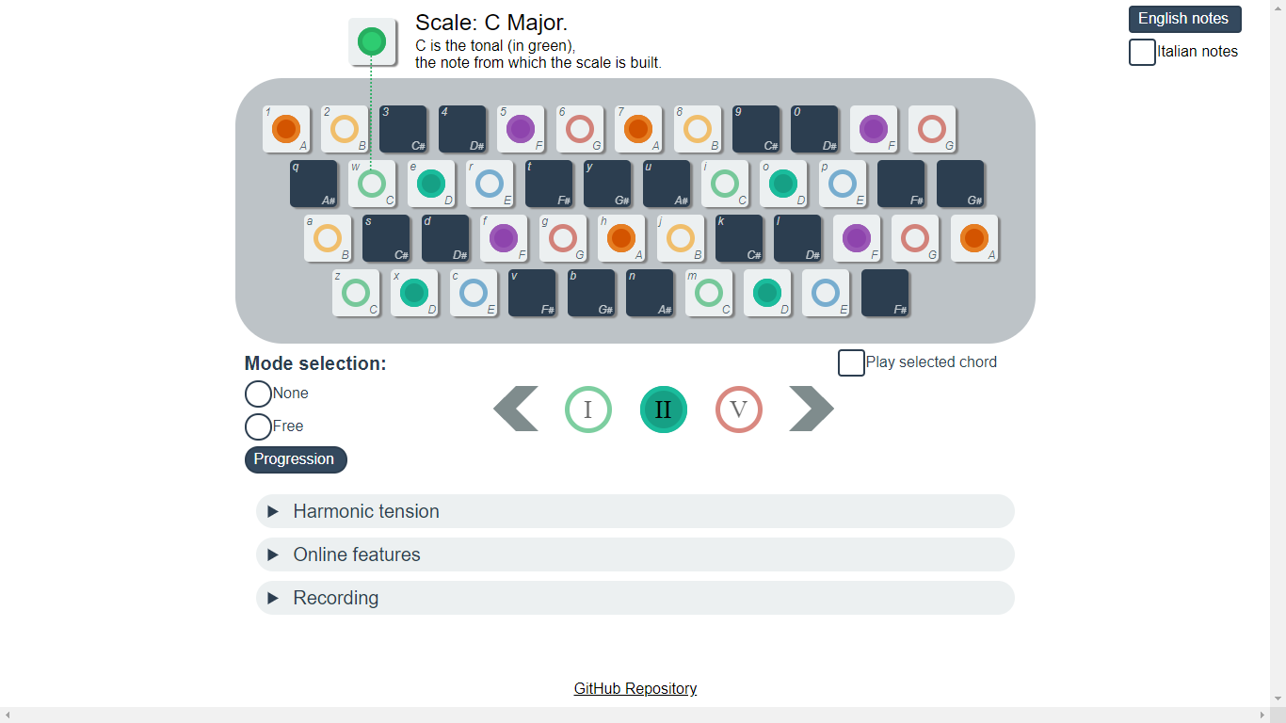
Mode selection mechanic

Slide 7
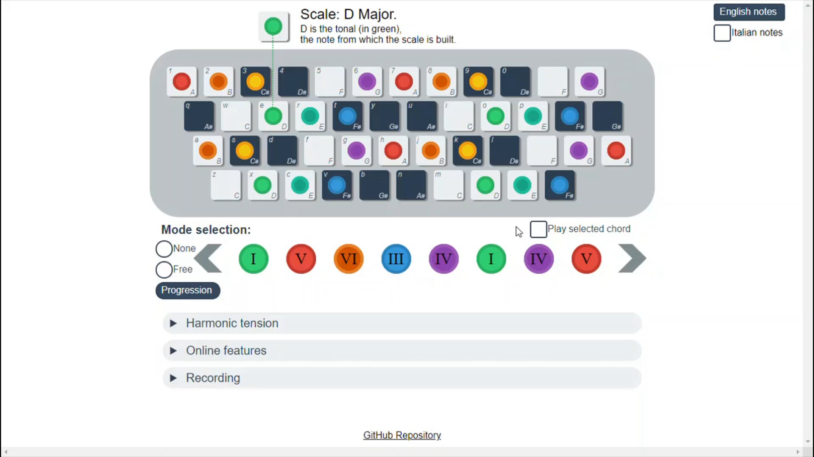
Hearing chords

Slide 8
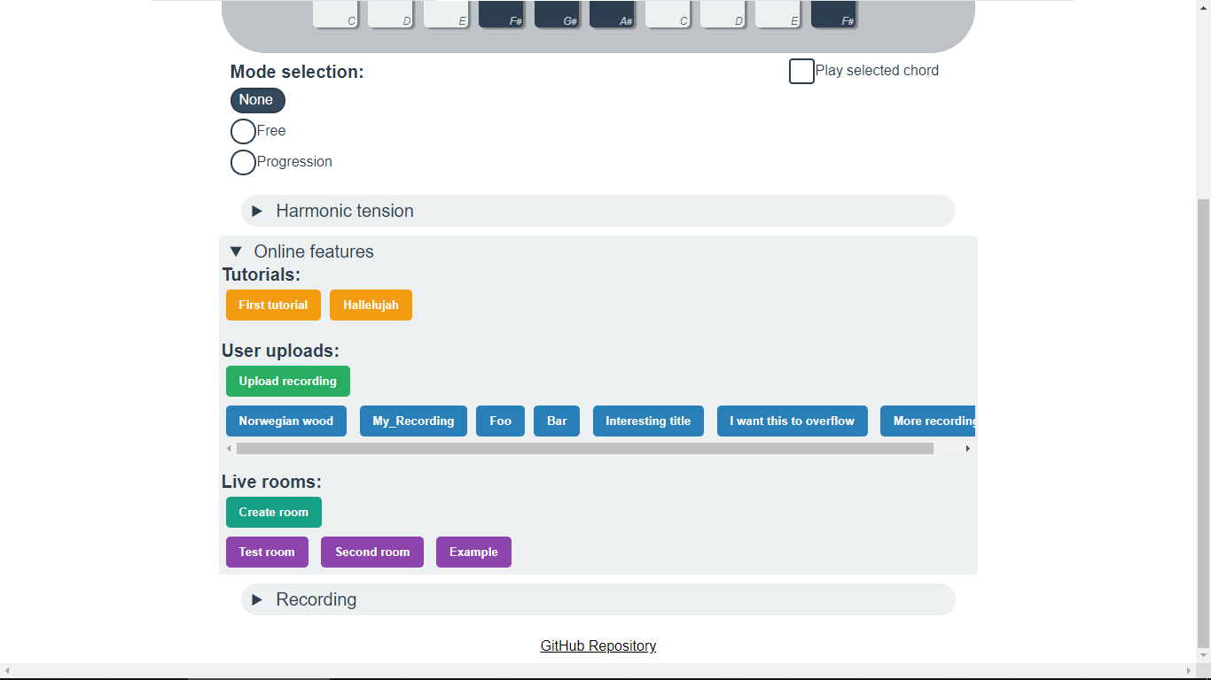
Online features

Slide 9
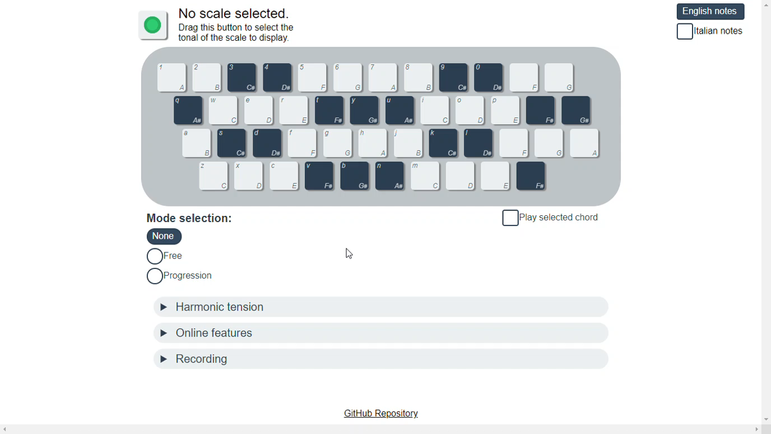
Tutorials

Slide 10
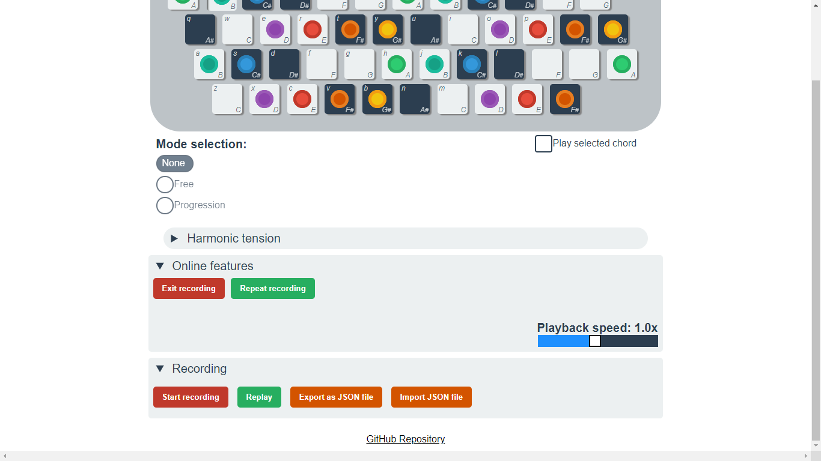
User uploads

Slide 11
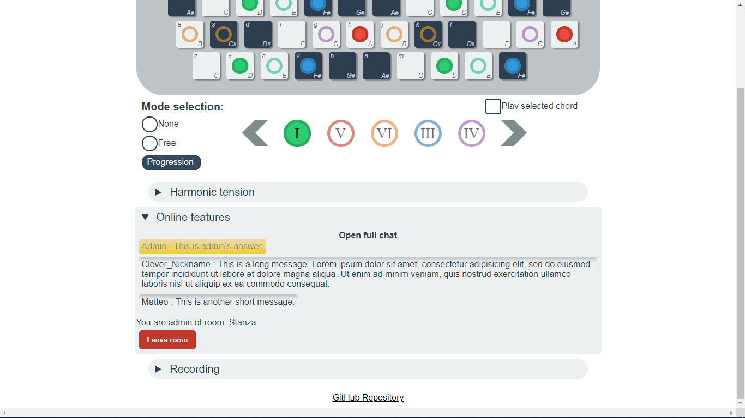
Rooms (for the admin)

Slide 12
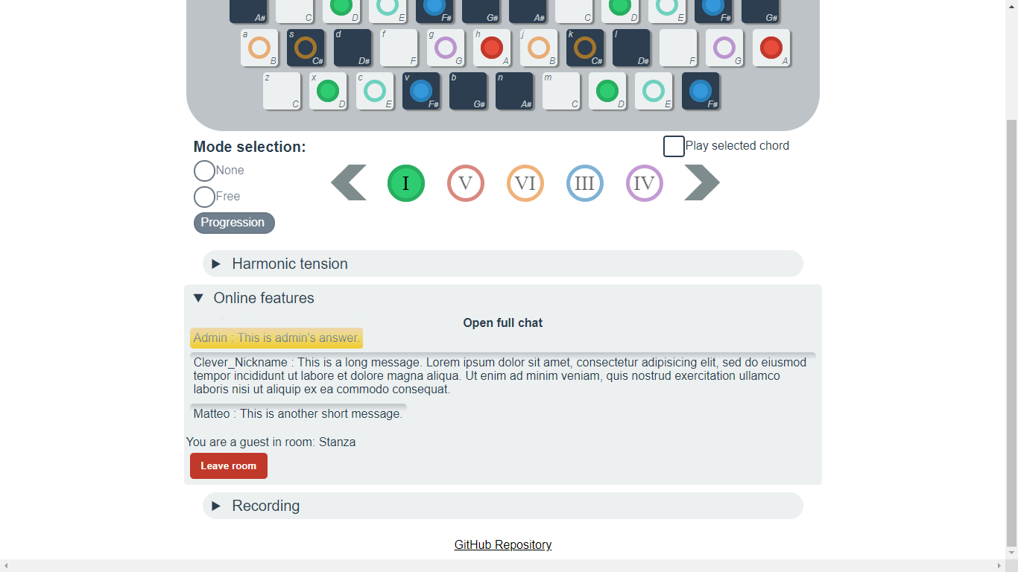
Rooms (for the guests)
Locked

Slide 13
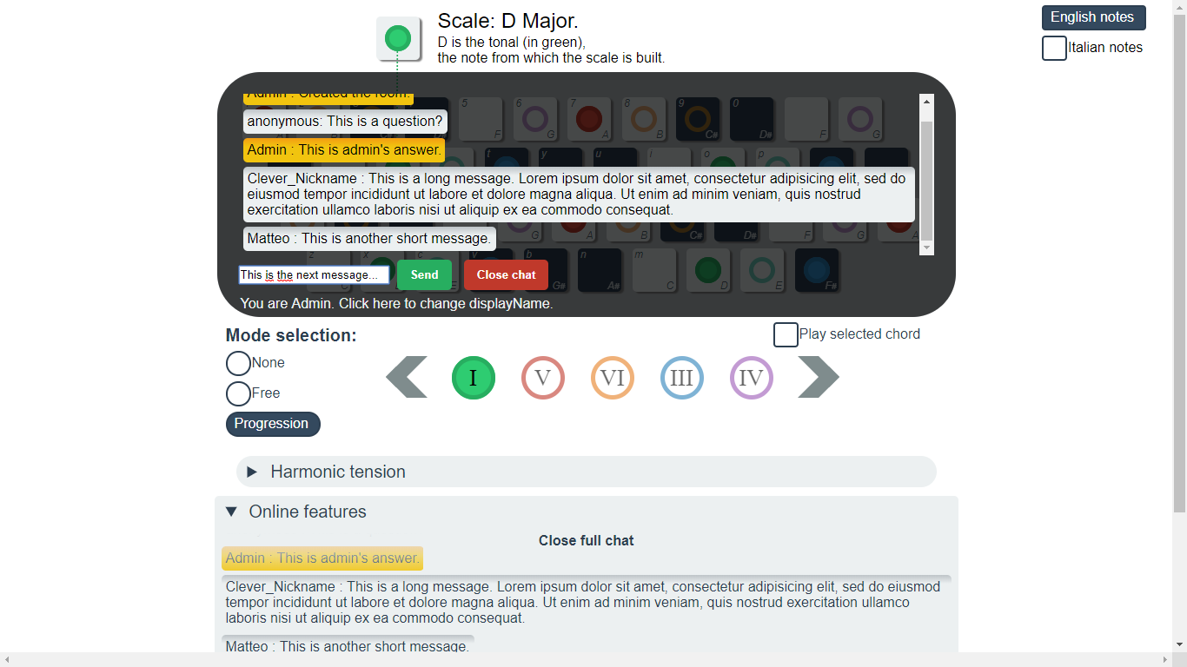
The full chat

Slide 14
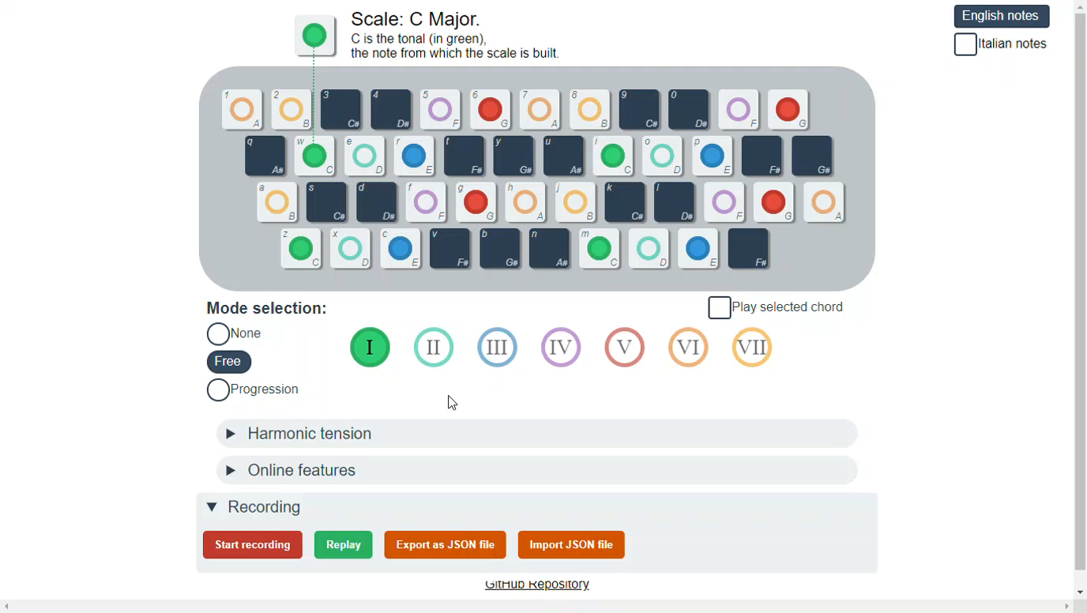
Recording

Slide 15
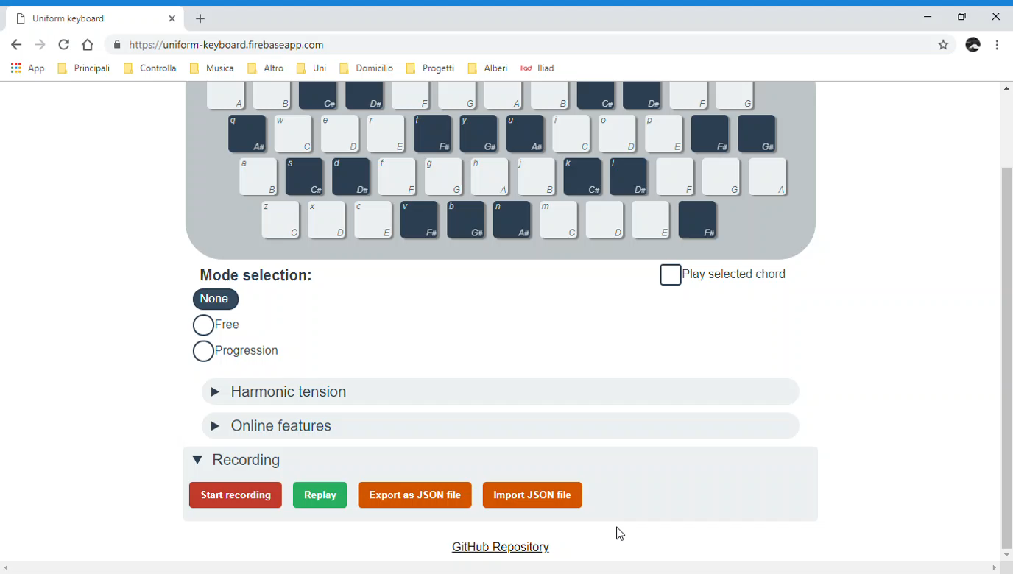
Importing files

Slide 16
Latency in rooms
Data from the Firebase DB is fetched in bursts, and the latency of such bursts is too unreliable: it is unfeasible for two or more users to play together in a live room.
To compensate for this jitter, when a keypress is heard from the server...
If it is the first keypress of a sequence, it is scheduled to be reproduced after a 0.5s delay.
If it isn't the first heard keypress, it is added to the list of keypresses to reproduce;
after a keypress is reproduced, the next one in line is scheduled to be reproduced after a delay that was computed by the "author" of the keypress (time elapsed since the last keypress on their part).
Hopefully, by the time the first keypress of the sequence is reproduced, the following ones have been heard from another DB burst, and the delay ensures keypresses are reproduced with the right delays between them, at least until the delay is too long. In that case the difference is not noticeable, anyway.

Slide 17
Behind the scenes
Room creation:
Create /rooms branch entry, setting user ID for authorization
Create /messages, /keypresses, and /settings branches, start pushing keypresses
Schedule room deletion on network disconnection
Room spectating:
Lock settings to the admin's
Start listening to the admin's keypresses
Can write messages, but only your own, everything else is read-only
If the /rooms entry is deleted, leave
Leaving a room:
If spectating, stop listening to all related branches
If admin, delete all branches saving the /rooms branch for last: it is required for ownership checks

Slide 18
Behind the scenes
tutorials:
names:
tutorial_name: true
data:
tutorial_name:
steps: #
keypresses: {}
settings: {}
messages: {}
uploads:
names:
owner: user ID
data:
file_name:
owner: user ID
keypresses:{}
settings: {}
rooms:
room_name:
owner: user ID
users:
u_id: {}
messages:
room_name:
push_ID: {}
settings:
room_name: {}
keypresses:
room_name:
push_ID: {}

Slide 19
Synths
There are as many synths as there are tones on the keyboard:
Keys that play the same note operate the same synth.
Each synth is made of
An oscillator (square)
A shelf filter (high frequencies quickly drop)
A gain node (gains starts at 0, quickly goes up and then down a bit)
All synths go into one compressor node to prevent clipping.

Slide 20
Thank you for your time
Questions?

